Slide 1
Human Perception of Chasing in Real Life
Nickname: Team Bolt
Evelyn Huang, Isabelle Carson, Sanya Nijhawan
Notes:
Isabelle

Slide 2
How does human perception of chasing change when the chasing occurs in real life as opposed to in a 2D animation?
Notes:
Isabelle
Draws on research from Professor Scholl's Perception and Cognition Lab at Yale, which researched how well humans could perceive whether, in a collection of moving white disks, one animated disk was "chasing" another disk.
They found that above 30 degrees, humans were no longer able to perceive chasing
Scholl's study had participants observe a 2D animation. We're interested in whether or not this same result occurs if we replicate the experiment in real life. We plan to replicate this experiment using multiple Spheros

Slide 3
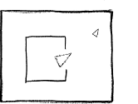
Animacy and Chasing
A lot of previous research focused on human perception of animacy
What triggers perception of animacy?
Chasing is one particularly interesting form of animacy
Animacy in robots
Abell et al. (2000)
Notes:
Like we talked about in 472, past studies have shown that moving shapes are perceived as alive, animate and as having goals. For example, based on different motion patterns, a large triangle, the mother, and the small triangle, the child are perceived to be interacting with their environment and each other.
In this static image example, the child was perceived to be “exploring outside”. Such perceptions of animacy and goal-directed movement of simple shapes are of great interest because they seem to hint at automatic visual processing (Gao, Newman & Scholl, 2009).
Chasing is something that is very concrete and specific and easily quantifiable to derive conclusions.
We have talked a lot about animacy in robots. We have seen robots showing reaction to stimuli, physical behavior and even language skills. As one study said, “These are typically attributed only to animals, and hence it can be argued that it makes sense to ask participants about their perception of the animacy of robots.”
Sanya

Slide 4
The Original Study
T. Gao et al. ( 2009)
Notes:
Gif of video of 0 degree chasing from original study
Source: http://perception.yale.edu/Brian/demos/Animacy-Chasing.html

Slide 5
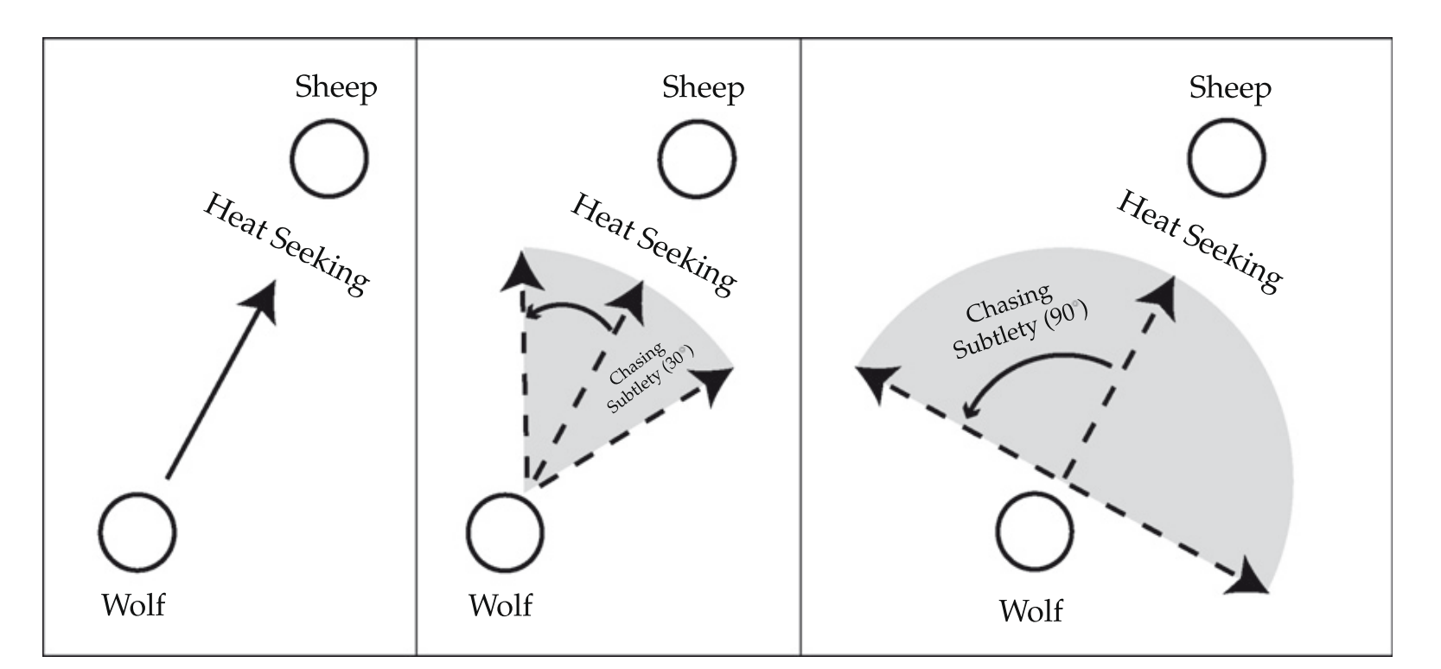
The Original Study
T. Gao et al. (2009)
Notes:
Evelyn
-Studied human perception of chasing using 5 white animated disks
-In ½ trials, move randomly, in other ½ there’s a wolf and a sheep

Slide 6
Approach
Notes:
Evelyn
-Two main differences: real life object and setting, and isometric view

Slide 7

Part 1: Programming Sphero Bolts
5 devices, each controlling one Sphero robot
Randomly generate trajectories similar to original studies
Use closed-loop control to program Sphero robots to follow paths
Use infrared communication to ensure robots start and stop in sync
Notes:
Isabelle

Slide 8
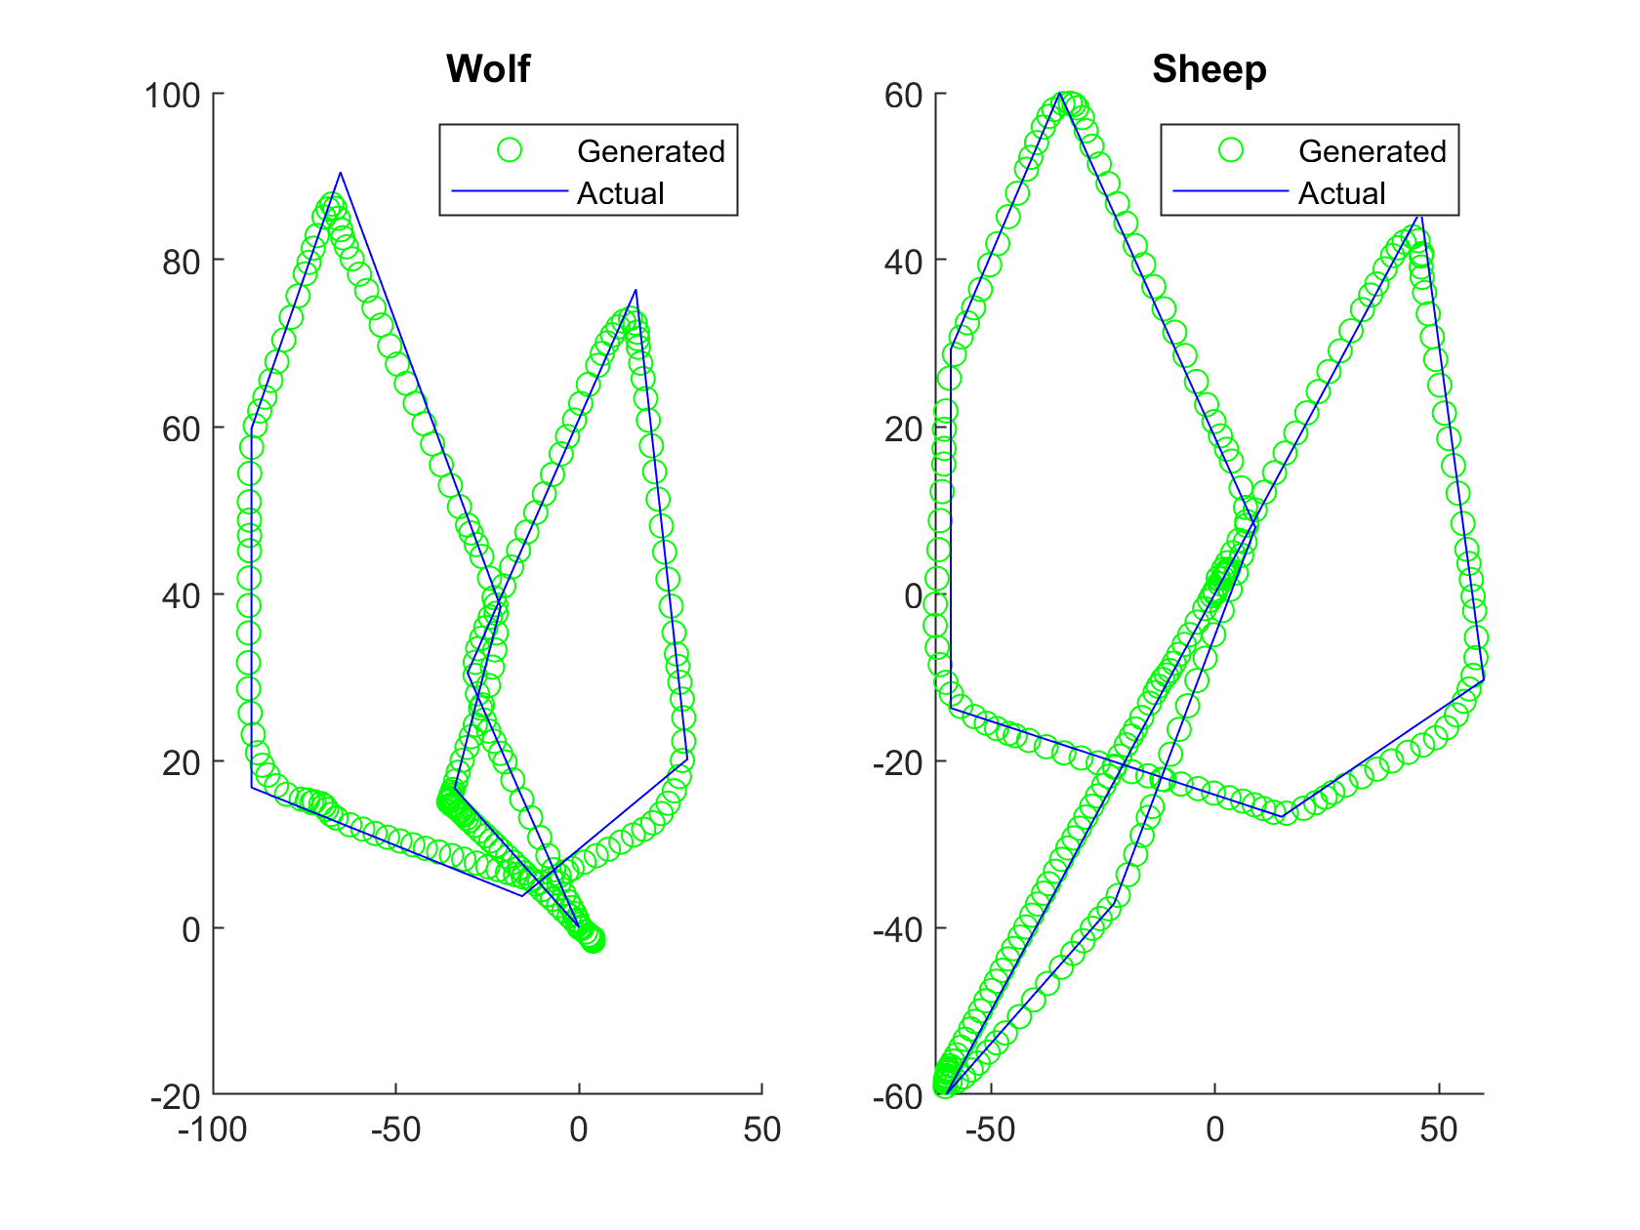
Part 2: Filming the Videos
Filmed trials using isometric view and selected best ones
Verify accuracy of wolf and sheep by comparing plotted sensor data to generated path
Edit videos to make Spheros easier to identify
Notes:
Evelyn

Slide 9
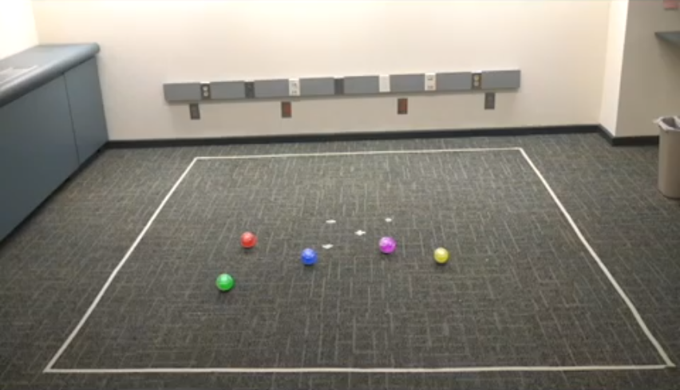
Part 3: Running the Study
Ran study on Amazon MTurk
Two versions: one with videos at original speed (~40min), one at 2x speed (~30min)
30 participants for each version
Each study had 48 trials: 24 chase present and 24 chase absent
Chase present consisted of 4 trials for each chasing angle
Notes:
Sanya

Slide 10
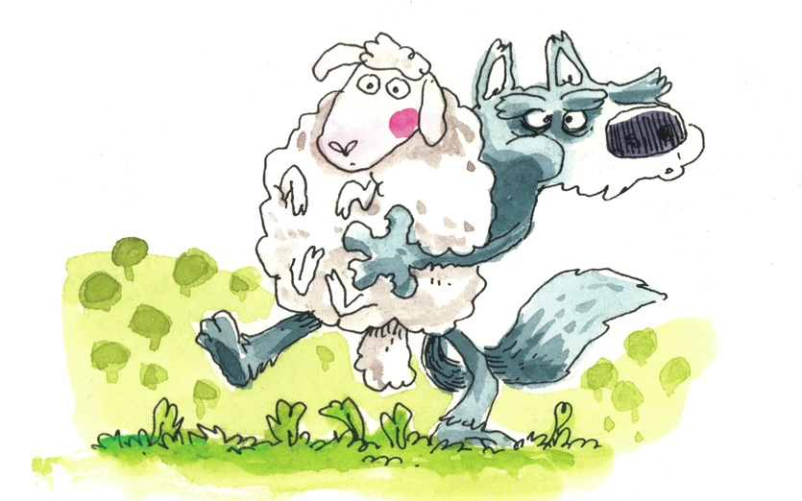
Study Metrics
After each trial, participant were asked whether a chase was present
If chase is correctly detected, they were asked to identify the wolf and sheep
Detection Accuracy: % correct of determining whether a chase was present
Identification Accuracy: % correct of identifying both the wolf and sheep correctly
Notes:
Sanya

Slide 11
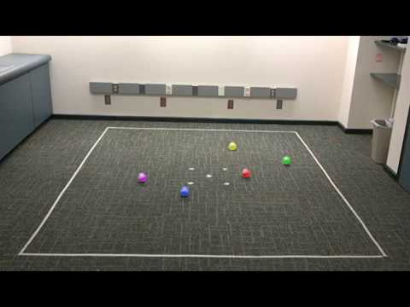
Was chasing present in this trial?
Notes:
Sanya
0 degree chase, Green is chasing red
Source: https://www.youtube.com/watch?time_continue=1&v=0VSkTLHofc8
Green is chasing red

Slide 12
Results
Notes:
Isabelle

Slide 13
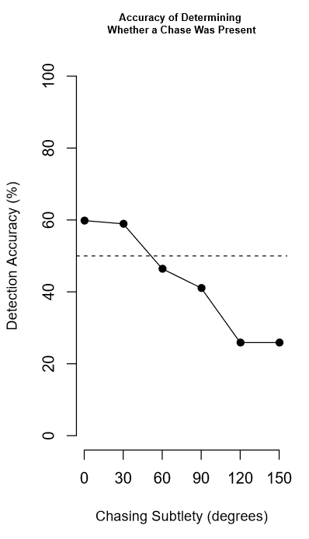
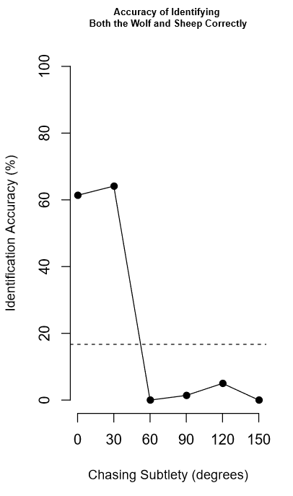
Results for Normal Speed
Notes:
Much lower rates than original study
Two possible explanations:
Amazon MTurk workers
Way we implemented chasing had sharper turns / more lag between wolf and sheep
Isabelle

Slide 14
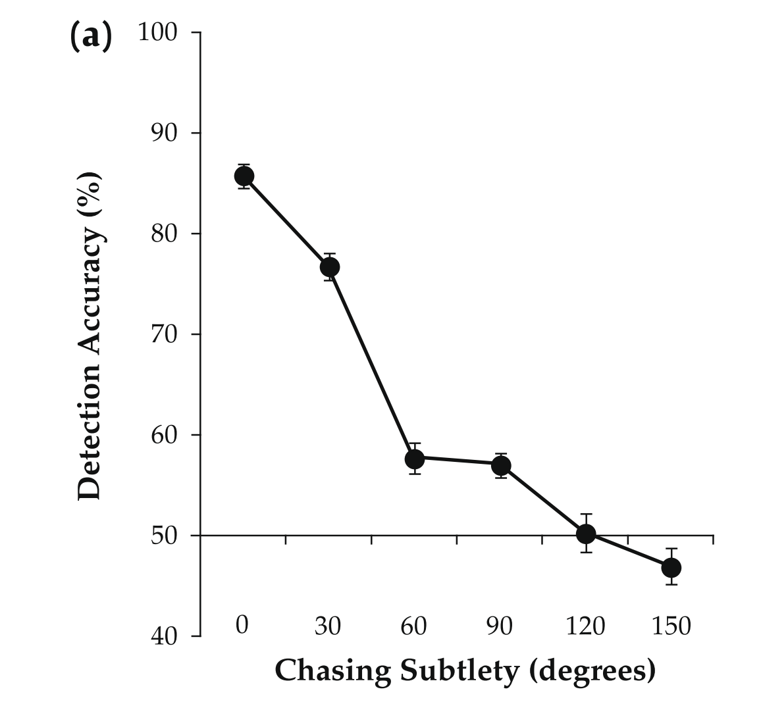
Comparing Detection Accuracy
T. Gao et al (2009)
Our study
Notes:
Isabelle

Slide 15
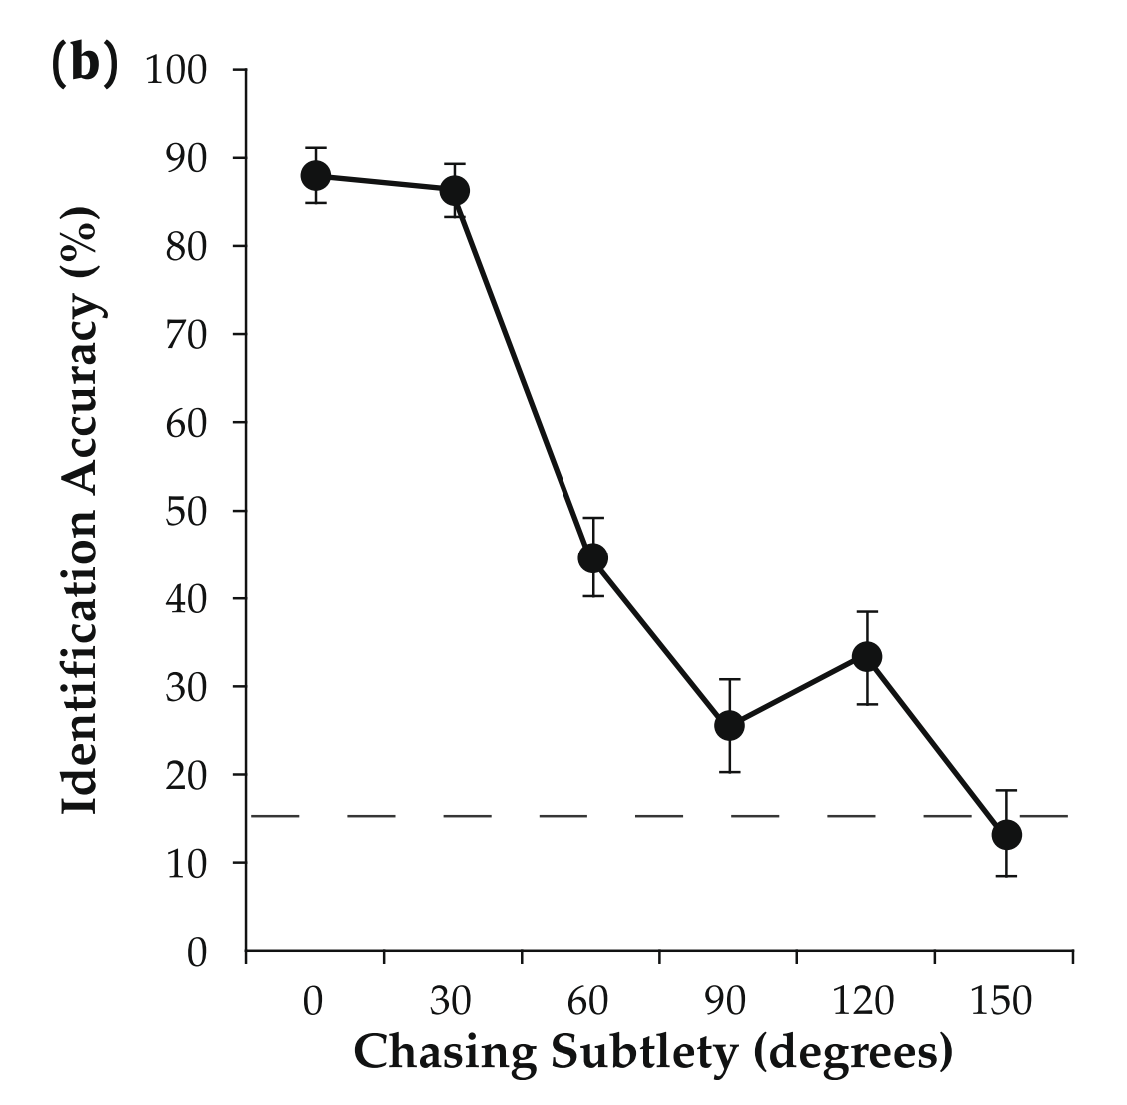
Comparing Identification Accuracy
T. Gao et al (2009)
Our study
Notes:
Isabelle

Slide 16
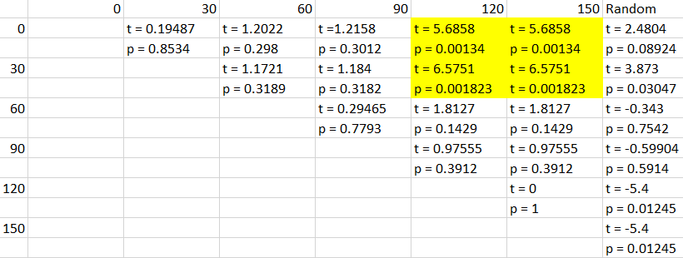
Results of Paired T-Tests
Notes:
Isabelle

Slide 17
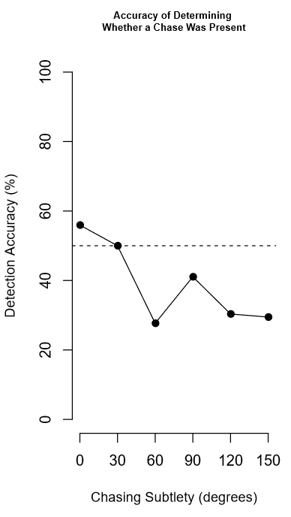
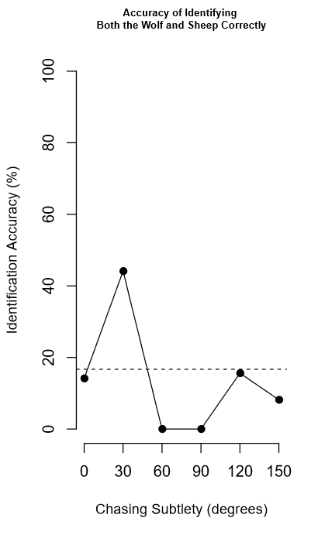
Results for 2x Speed
Notes:
Trends do not match original study or normal speedy
Experimental issues that didn’t

Slide 18
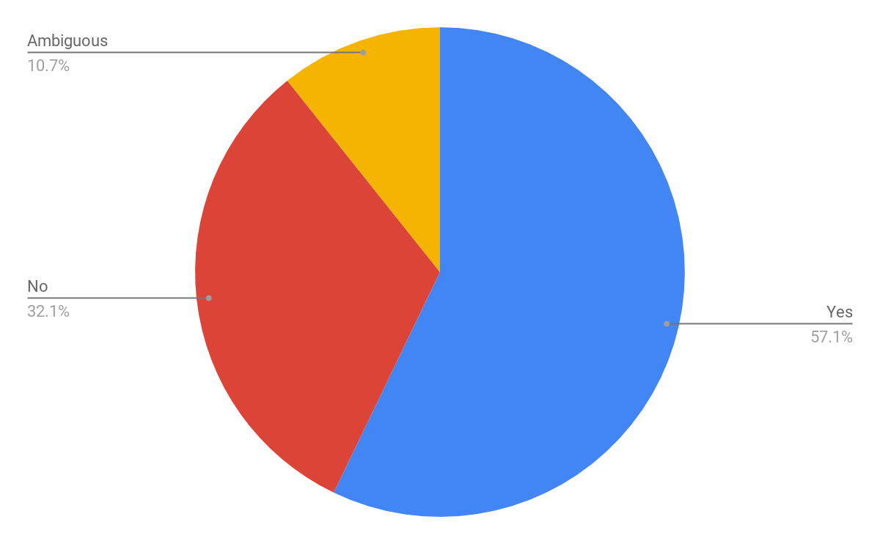
Did you view the robots as animate objects?
Notes:
Sanya

Slide 19
Summary
At normal speed, results followed trends of original study
Participants could not reliably see chasing subtlety beyond 30 degrees.
Lower rates of detection and identification accuracy
Participants had more trouble detecting and identifying chases at 2x speed
Interesting results about animacy

Slide 20
Conclusions + Future Work
We saw similar trends to the original study, so we can conclude that the original study’s results can be extended to real life.
In the future, do in-person studies rather than video studies
Replicate more of the experiments in the original study

Slide 21
Thank you!
Notes:
Thanks to Sarah and Scaz

Slide 22
Supplemental

Slide 23
What made this task difficult?
“This task was difficult because all five robot's were mostly moving at the same speed. It was also difficult because the robot movement when chasing are not at all similar to that of animals; they do not closely trail the robot they are chasing nor do they try to corner their target.”
“The behavior is fairly hard to discern, as some examples were very subtle. There were several where I was fairly certain that there was pursuit that there wasn't.”
“I couldn't watch all the balls at once because there were too many”

Slide 24
Did you view the robots as animate objects?
“Yes like little bugs”
“No I reserve that for cartoons”

